Slide 1
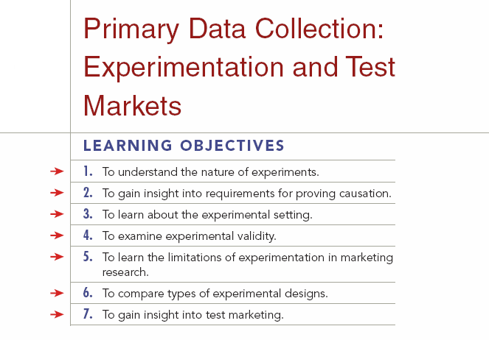

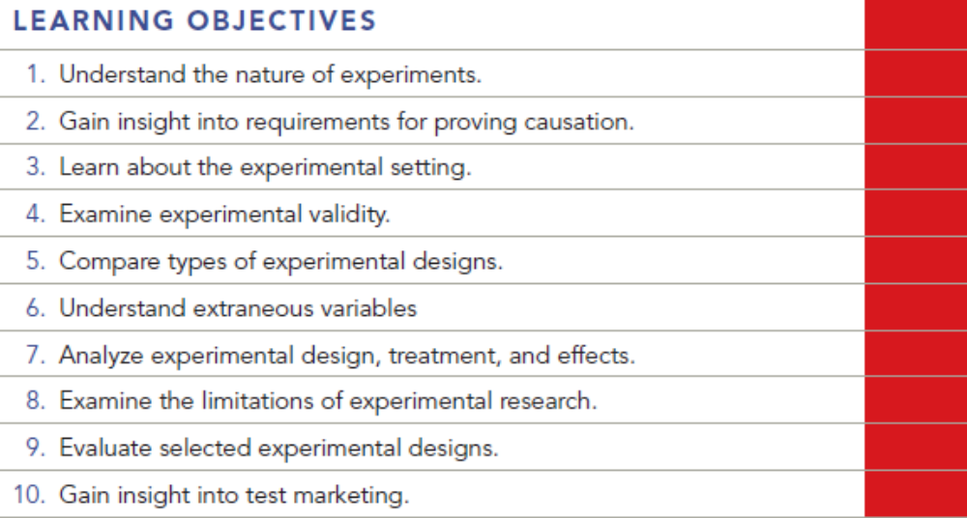
Chapter Nine
9-1

Slide 2
Question
Design a test of a new pricing strategy for orange juice concentrate. The brand is an established brand, and we are only interested in testing the effect of a 5 percent price increase and a 5 percent price decrease. All other elements of the marketing mix will remain the same.

Slide 3
Answer
Randomly select three experimental groups. Expose Group 1 to the product at the 5% price increase, expose Group 2 to the 5% price decrease, and expose Group 3 (the control group) to the original price. Use a questionnaire to measure post-test attitudes about product pricing and purchase intentions.

Slide 4
Question
A soft drink company has determined in taste tests that consumers prefer the taste of their diet product when sweetened with Splenda in comparison to Equal. Now they are interested in determining how the new sweetener will play in the marketplace. Design a test market that will achieve this goal.

Slide 5
Answer
Select four test market cities. Offer the soft drink sweetened with Splenda in two test markets, and sweetened with Equal in two test markets. Try to match markets as closely as possible to minimize the effect of extraneous variables.
Compare the results on a daily basis for at least 90 days. This should be a pretty important decision because the cost of test marketing can run into the millions of dollars. Perhaps a similar design could be used employing simulated test markets. The cost would be much lower.

Slide 6
Question
A national pizza chain wants to test the effect on sales of four different discount coupons. Design a test that will do this in a way that gives a clear read. Your focus should be on the effect on sales volume. Financial analysis after the test results are in will address the revenue and profit impact.

Slide 7
Answer
Randomly select five experimental groups. Distribute Coupon A to one group, Coupon B to a second group, and so on. The fifth group, the control group, would get no coupon.
Compare the pizza purchase and coupon redemption rates of the five groups. One thing to watch for would be whether subjects who received a particular coupon actually use it as part of the purchase process. Compare results for the five groups to see which makes the largest number of pizza purchases.

Slide 8
Question
A national value-priced hotel chain needs to understand the business impact of including a free buffet style breakfast to guests.
Design and justify a test that will do this. Do some preliminary investigation to determine what items the target market of guests would prefer in a breakfast buffet. Do a follow-up survey to get a preliminary idea of the impact on purchase behavior the buffet might have. Will there be any change in price? Once it has been established that guests in the target market would want the breakfast buffet, a test market could be conducted to see “real” results.

Slide 9
Answer
Select six hotels from the chain that are as much alike as possible. Capture demand statistics for the year prior to the test. Assign three of the units as test sites (offer the breakfast buffet), and three units as control sites (no buffet). Continue to measure demand for another six-month period. Compare pre-test and test market performance of the six properties. Differences in demand may be due to the availability of the breakfast buffet.

Slide 10
Question
Read PRACTICING MARKETING RESEARCH
What Happens When Your Selection Bias Is the Interviewer’s Gender?
Question: What types of possible (even if subtle) bias might result from male respondents answering an e-mail survey sent or signed by a female?

Slide 11
Answer
Given the email survey didn’t have a picture of the female interviewer, there would not have been any interviewer bias, except that the male respondent knew a female sent the questionnaire.
If there were any subtle differences in the print or language in the survey, that could account for differences. If the surveys were identical, then only gender would have possibly accounted for the difference in response rate. It has been long established in telephone interviews that females get more response per capita than males; hence, telephone call centers are populated largely with females.

Slide 12
Question
The “treatment” is also referred to as which of the following?
increase in sales
change in market share
gross margin
independent variable
none of these

Slide 13
Answer
Ans: D

Slide 14
Question
Which of the following types of research allows the researcher to show causation?
survey
observation
experiment
none of these

Slide 15
Answer
Ans: C

Slide 16
Question
Research that is designed to determine whether a change in one variable likely caused change in another variable is referred to as _______________.
exploratory research
causal research
descriptive research
none of these

Slide 17
Answer
Ans: B

Slide 18
Question
Concomitant variation occurs when 2 variables are _______.
causally related
experimentally related
correlated
none of these

Slide 19
Answer
Ans: C

Slide 20
Question
In an experiment where the marketer is interested in finding out the impact of shelf position on a product’s sales, the shelf position is considered the __________variable.
correlation
dependent
independent
concomitant
none of these

Slide 21
Answer
Ans: C

Slide 22
Question
Which of the following is the main disadvantage of laboratory experiments?
Exploratory research is enhanced.
The laboratory setting may not be a good representation of the real-world setting.
Concomitant variation is not possible.
Elimination of causal factors is increased.
none of these

Slide 23
Answer
Ans: B

Slide 24
Question
Test markets are which of the following type of experiment?
controlled experiment
exploratory experiment
field experiment
laboratory experiment
none of these

Slide 25
Answer
Ans: C

Slide 26
Question
An experiment is designed to test how consumers go about choosing life insurance policies. If this experiment uses a sample of college students, it would likely not have _______.
internal validity
extraneous validity
external validity
laboratory validity

Slide 27
Answer
Ans: C

Slide 28
Question
Suppose during an experiment, a researcher used several observers to record the results. The results of the experiment were perplexing to the researcher. In such a case one might expect ___________ to have occurred, distorting the results of the experiment.
maturation
history
instrument variation
mortality
selection bias

Slide 29
Answer
Ans: C

Slide 30
Question
This true experimental design involves random assignment of subjects to experimental and control groups, but no pre-measurement of the dependent variable.
Solomon four-group design
before and after with control group
after only with control group
one group pretest and posttest design
none of these

Slide 31
Answer
C

Slide 32
Question
Which of the following is often the most important data produced by a test market?
purchase data
awareness data
competitive response
source of sales
none of these

Slide 33
Answer
Ans: A

Slide 34
Question
Your client is interested in determining which of two Internet banner ads is more effective. Design a field experiment. Be sure to identify the independent and dependent variables.

Slide 35
Answer
Ans: The independent variable is whether the respondent sees ad A or ad B. The dependent variable would possibly be the click through rate of each ad. Students should mention that these ads should be shown randomly to subjects, and whichever ad had a higher click through would be deemed most effective.

